Slide 1
Discover What Many Other Practices Already Know
Help to IMPROVE patient’s quality of care
Help to LOWER Anesthesia mortality rates
Help to LOWER Anesthesia Incidents
Fifty Facts In
50 Minutes:
An Update From AQI
Richard P. Dutton, M.D. M.B.A.
Executive Director
©2013 AQI
Helping Anesthesia Professionals Improve Patient Care

Slide 2
TODAY IS MEANT TO:
Provide the history and purpose of AQI
Give an update on AQI progress and future goals
Educate professional anesthesiologists
Helping Anesthesia Professionals Improve Patient Care

Slide 3
US Cost of Healthcare
$2,700,000,000,000 in 2011
Grew 4% from 2010
18% of G.D.P.
Equal to the economy of France
Almost twice the $/GDP as Norway
1/3 ($850B) goes to Hospitals
1/4 ($750B) wasted, per the IOM

Slide 4
The Anesthesia Quality Institute
A “related organization” of the ASA
Non-commercial, non-profit
Created to improve the quality of anesthesia care
… by means of the National Anesthesia Clinical Outcomes Registry
… and other registries as needed
AIRS, PPPAI, PAIN, Closed Claims, POVL, Awareness, NINS
Helping Anesthesia Professionals Improve Patient Care

Slide 5
AQI Registries
NACOR
AIRS
PPAI
Closed Claims Project

Slide 6
13.2 MILLION CASES
166 practices
2,050 facilities
20,000 Providers
2 MILLION CASES
40 practices
386 facilities
2,575 providers
7.1 MILLION CASES
93 practices
773 facilities
6,551 providers
Launched AQI
336,469 CASES
13 practices
86 Facilities
666 Providers
2009
2010
2011
2012
2013
Helping Anesthesia Professionals Improve Patient Care

Slide 7
That was then…
This is now…
Here is our future…
AQI will be the “one stop shop” for ASA members & their practice groups to obtain business benchmarking data.
AQI hopes to have data from the majority of the anesthesia practices in the United States
Over 13 million cases
AQI also launched the PUF (participant user file) & AIRS (Anesthesia Incident Reporting System)
AQI is developing a hospital reporting system
Launched 2009
A non-profit related organization of the ASA
Created to improve the quality of anesthesia care
Helping Anesthesia Professionals Improve Patient Care

Slide 8
NACOR: The Anesthesia
Clinical Outcomes Registry
Electronic capture
All cases (no bias)
All available data
De-identified, but with context
Automated reporting
Automated validation
Analysis and reporting
Helping Anesthesia Professionals Improve Patient Care

Slide 9
13 Million Cases
Adding 2,500,000 cases per quarter
Will capture 15% of all the anesthesia cases in the U.S. in 2013
The largest registry of its kind
Registry 2.0 – no abstraction or eyeballs
20,000 Anesthesia Providers
2,100 Facilities
Helping Anesthesia Professionals Improve Patient Care

Slide 10
What NACOR Collects
Administrative data 13m cases
Outcomes data 2m
AIMS data 1m
Hospital EHR data soon
Helping Anesthesia Professionals Improve Patient Care

Slide 11
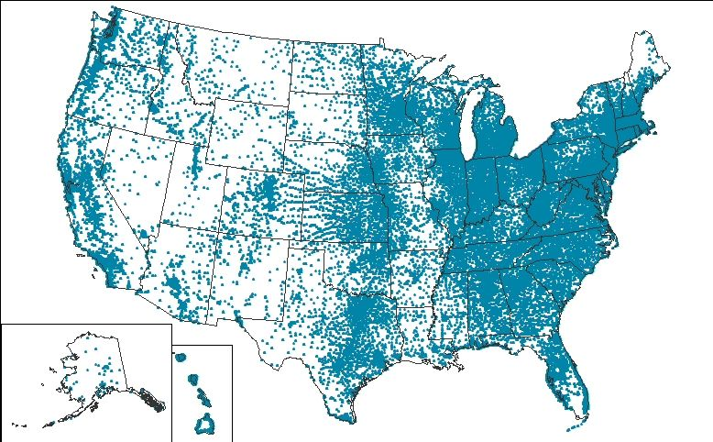
# of Cases in Each State
Helping Anesthesia Professionals Improve Patient Care

Slide 12
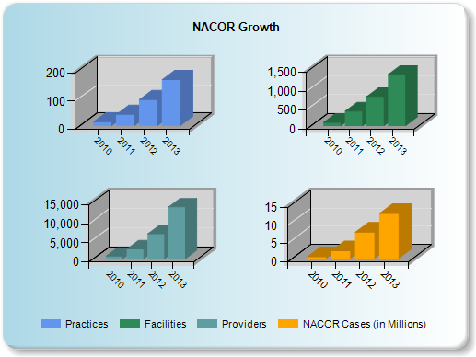
Year | Practices | Facilities | Providers | Cases
2010 | 13 | 86 | 666 | 336,469
2011 | 40 | 386 | 2,575 | 2,005,367
2012 | 93 | 773 | 6,551 | 7,144,753
2013 | 165 | 1,362 | 13,653 | 12,285,543
Helping Anesthesia Professionals Improve Patient Care

Slide 13
The “Average” Practice
31 anesthesiologists
32 nurse anesthetists
Working in 7 facilities
Doing 30,600 cases per year
Helping Anesthesia Professionals Improve Patient Care

Slide 14
Practice Size
University
11% of practices
25% of anesthesiologists
15% of cases
Large private
Medium private
Small private
Helping Anesthesia Professionals Improve Patient Care

Slide 15
Practice Size
University
14% of practices
29% of anesthesiologists
31% of cases
Medium private
Small private
Large Private
Helping Anesthesia Professionals Improve Patient Care

Slide 16
Practice Size
University:
Large private
38% of practices
31% of anesthesiologists
39% of cases
Small private
Medium private
Helping Anesthesia Professionals Improve Patient Care

Slide 17
Practice Size
University:
Large private
Medium private
36% of practices
10% of anesthesiologists
14% of cases
Small private
Helping Anesthesia Professionals Improve Patient Care

Slide 18
Helping Anesthesia Professionals Improve Patient Care

Slide 19
Helping Anesthesia Professionals Improve Patient Care

Slide 20
Helping Anesthesia Professionals Improve Patient Care

Slide 21
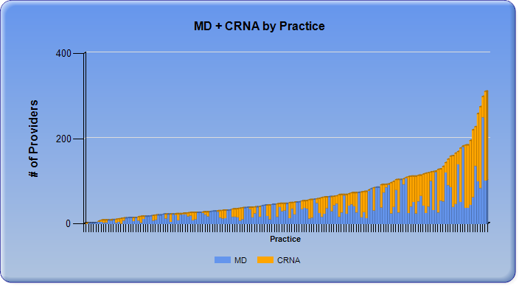
Helping Anesthesia Professionals Improve Patient Care

Slide 22
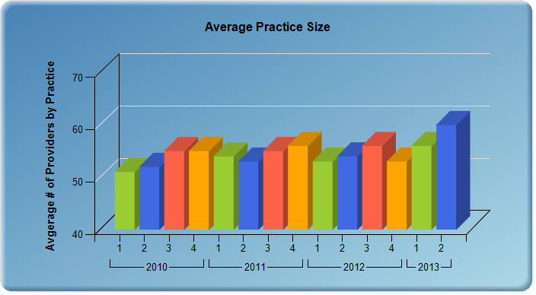
Helping Anesthesia Professionals Improve Patient Care

Slide 23
Helping Anesthesia Professionals Improve Patient Care

Slide 24
Helping Anesthesia Professionals Improve Patient Care

Slide 25
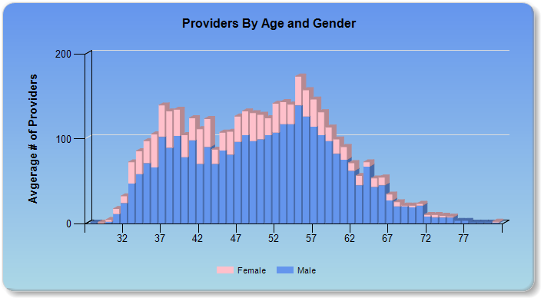
Helping Anesthesia Professionals Improve Patient Care

Slide 26
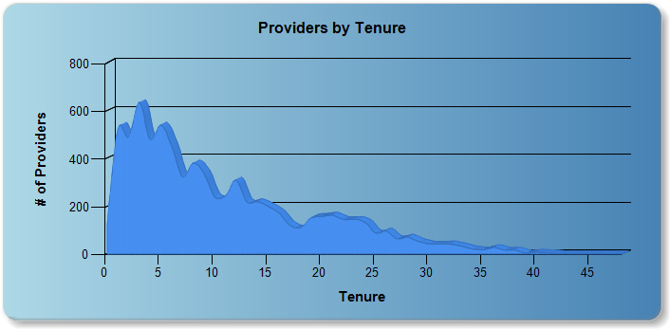
Helping Anesthesia Professionals Improve Patient Care

Slide 27
Anesthesiology Subspecialties
Helping Anesthesia Professionals Improve Patient Care

Slide 28
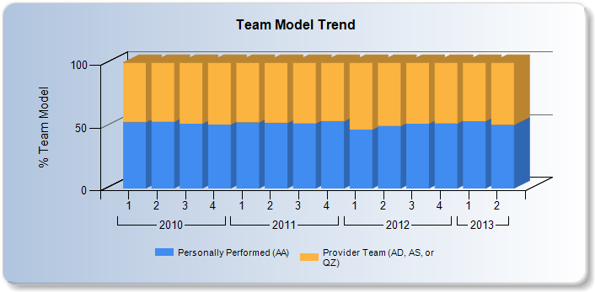
Helping Anesthesia Professionals Improve Patient Care

Slide 29
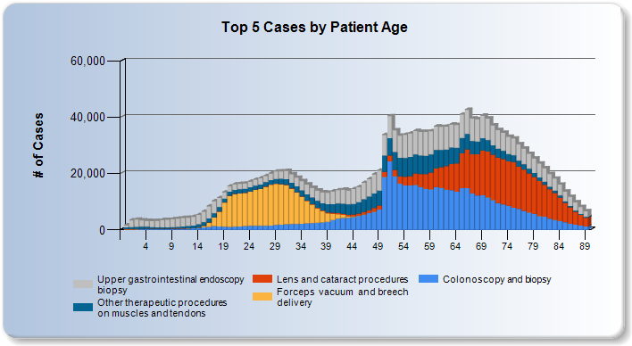
Helping Anesthesia Professionals Improve Patient Care

Slide 30
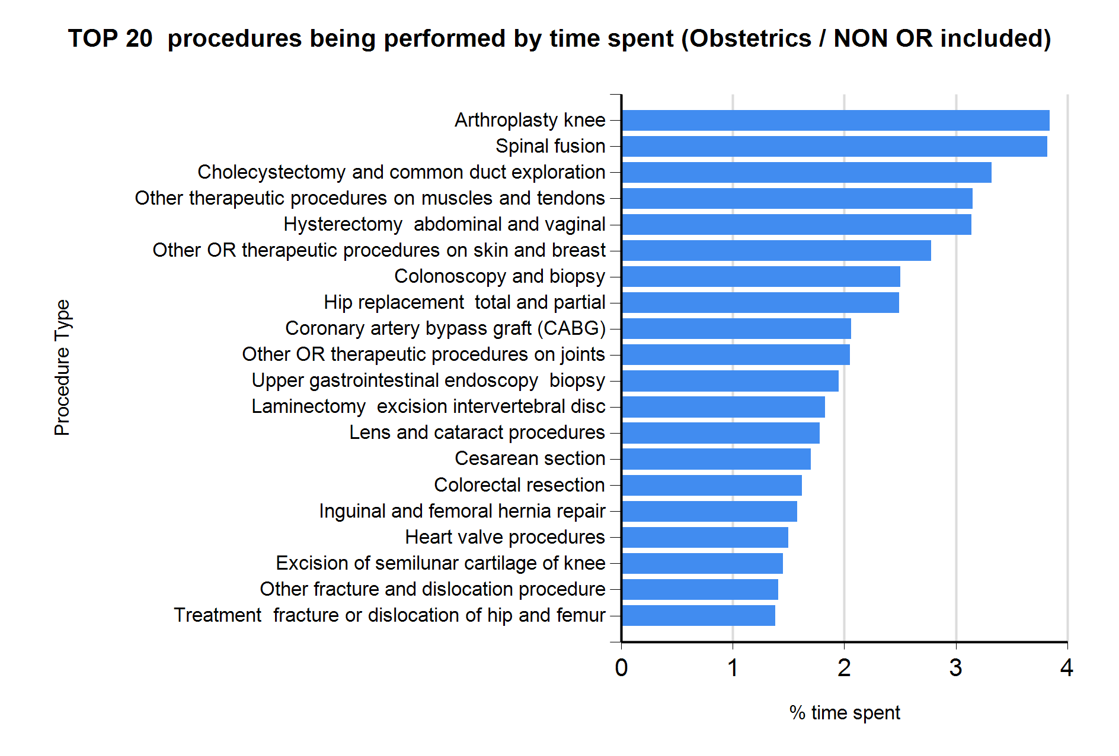
Helping Anesthesia Professionals Improve Patient Care

Slide 31
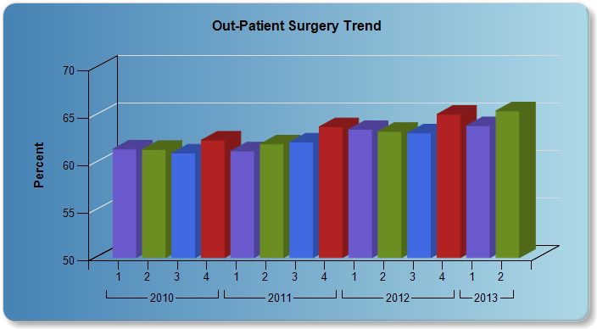
Helping Anesthesia Professionals Improve Patient Care

Slide 32
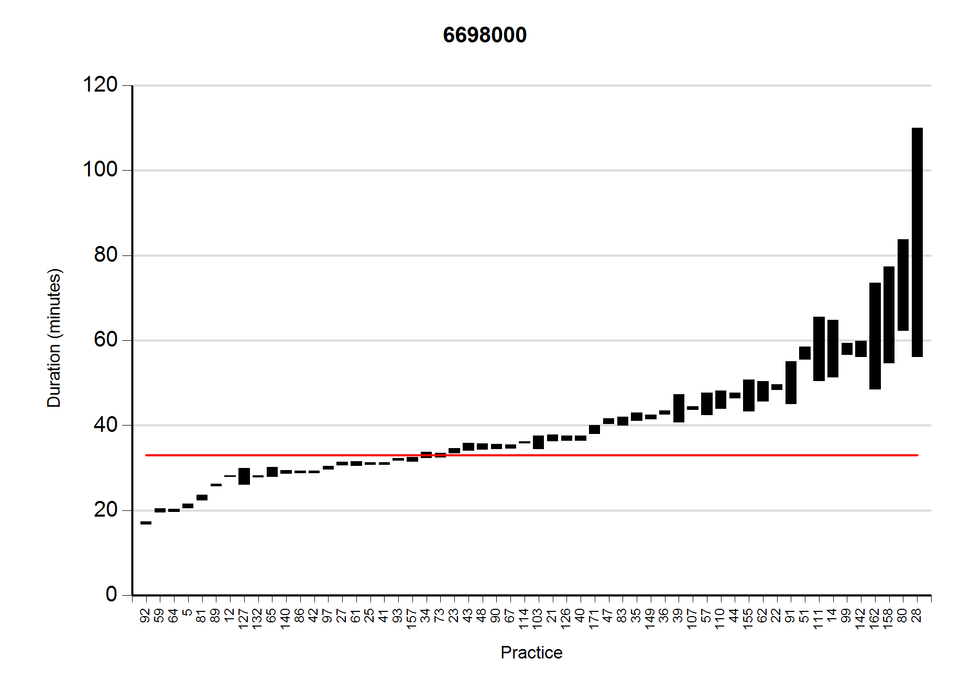
Mean Case Time by Practice -- Cataract
Helping Anesthesia Professionals Improve Patient Care

Slide 33
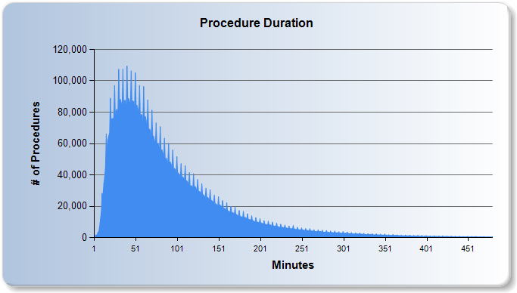
Helping Anesthesia Professionals Improve Patient Care

Slide 34
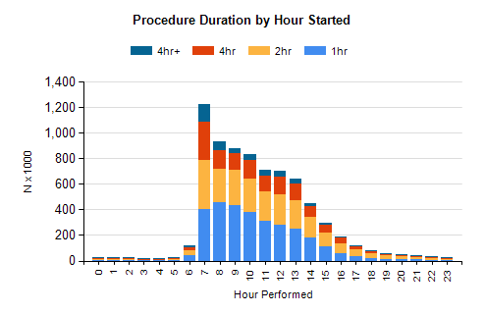
Case Start Time and Duration
Helping Anesthesia Professionals Improve Patient Care

Slide 35
Average Turnover-All Cases
Helping Anesthesia Professionals Improve Patient Care

Slide 36
Finding Data in NACOR
All Cases in NACOR
N = 11,563,349
Removed 1,013,812 Obstetric Cases
N = 10,549,537
Removed 206,316 Pain Cases
N = 10,343,221
Removed 2,097 ASA Physical Status 6
N = 10,341,124
Removed 7,200,179 (emergency Cases, cases not preformed in the OR, cases without duration, and time interval between cases > 90 minutes etc.)
N = 3,140,945
Practices: 144
Facilities: 963
Providers: 9,987
Provider Teams: 193,874
Helping Anesthesia Professionals Improve Patient Care

Slide 37
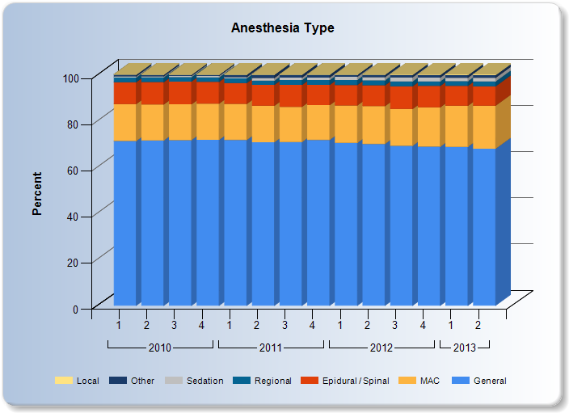
Helping Anesthesia Professionals Improve Patient Care

Slide 38
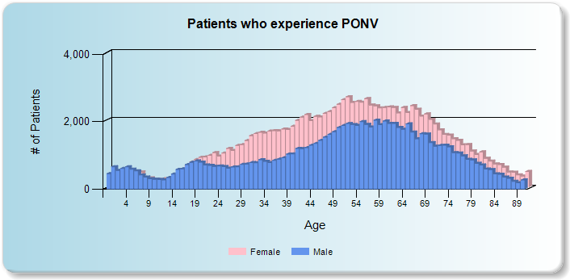
Helping Anesthesia Professionals Improve Patient Care

Slide 39
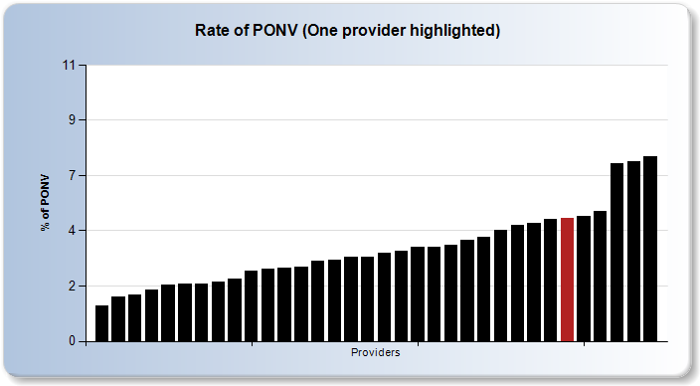
Helping Anesthesia Professionals Improve Patient Care

Slide 40
Why PONV is a Good Metric
Patients hate it
We know how to prevent it and treat it
It’s common
Can measure at the individual level
Can improve quickly
Improvement requires system thinking and collaboration with others
Helping Anesthesia Professionals Improve Patient Care

Slide 41
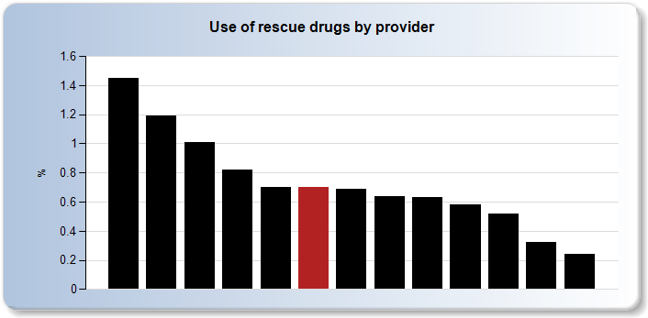
Helping Anesthesia Professionals Improve Patient Care

Slide 42
OR and PACU
Outcomes in 2m Cases
MORTALITY
0.03%
Minor:
10.21%
Major:
0.52%
Helping Anesthesia Professionals Improve Patient Care

Slide 43
Perioperative Mortality
we are here
Deaths
Rate
Risk Adjusted Deaths
Helping Anesthesia Professionals Improve Patient Care
Time, Scientific Progress

Slide 44
Putting on A.I.R.S.-
Anesthesia Incident Reporting System
> 1,000 cases to date
95% “confidential”
70 Institutions
100 Providers
27 Newsletter Items
A couple of trends
Helping Anesthesia Professionals Improve Patient Care

Slide 45
‘Learning’ from A.I.R.S
Unintended hazards of AIMS, EHR
Air embolus during ERCP
Errors due to medication shortages
Teamwork, cognitive aids

Slide 46
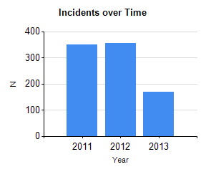
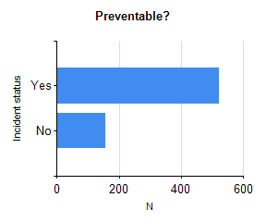
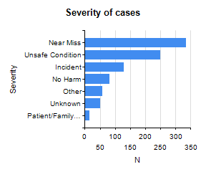
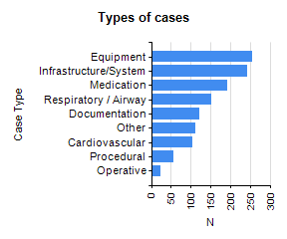
A.I.R.S.

Slide 47
MOCA--PPAI
Addresses the Part IV requirements
ABA approved modules available from ASA
8 modules now, 4 more in the coming year
Clinical data from real-world practice
AQI holds and aggregates the data

Slide 48
PQRS
72% of AQI practices report PQRS measures
Most report antibiotics, PACU normothermia and adherence to the central line bundle
Anesthesiologists also report on current smoking status, registry participation, and a wide variety of pain measures
AQI is a certified PQRS vendor
Helping Anesthesia Professionals Improve Patient Care

Slide 49
AQI Educational Resources
Nuts and bolts of quality management
Outcomes of interest
Data capture templates
Anesthesia QM references and links
List of acronyms
Links to information technology vendors
http://aqihq.org/resources.aspx
Helping Anesthesia Professionals Improve Patient Care

Slide 50
Participant User File
Yearly files of aggregated, de-identified, cleaned and validated data
Available to any NACOR Participant
Simple Data Use Agreement:
Must state the purpose of use
Commitment to confidentiality
Must acknowledge AQI as the source
Helping Anesthesia Professionals Improve Patient Care

Slide 51
AQI Research Collaborations
Academic
Stanford
OHSU
U. of Washington
UCSF
SOAP
SPA
ASRA
NQRN
FDA
MPOG
ASA HPR
Dartmouth
Yale
Mount Sinai
Columbia
U. of Maryland
Cleveland Clinic
U. of Chicago
Northwestern
UT Houston
U. of Colorado
UCLA
Organizations
Helping Anesthesia Professionals Improve Patient Care

Slide 52
Contact Us!
www.aqihq.org
or
r.dutton@asahq.org

