Slide 1
Improvement Activity Attestation using the NACOR Dashboard
Individual and Group Reporting
March 2018

Slide 2
Reporting Improvement Activities
Select from list of Improvement Activities supported by AQI
Practice performs activity for a minimum of 90 days
Practice attests via AQI
Practice maintains documentation for 6 years
Contact CMS directly (qpp@cms.hhs.gov) to verify documentation is sufficient
Download: Exhaustive CMS document with documentation requirements: https://qpp.cms.gov/docs/QPP_MIPS_Data_Validation_Criteria.zip
REMINDER: You are already performing PSPA_1!

Slide 3
Attesting to an Improvement Activity – Individual Attestation

Slide 4
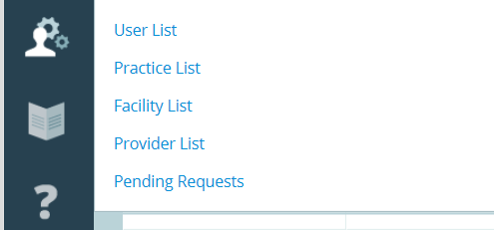
Improvement Activities (IA) – Individual Attestation
Attest through the Provider List in the NACOR Dashboard
Select the User Management Icon
Select Provider List

Slide 5
Improvement Activities (IA) – Individual Attestation
Select a Provider to access the “Edit Provider” Page
Click on the provider’s name to select

Slide 6
Improvement Activities (IA) – Individual Attestation
Once you are on the “Edit Provider” Page – scroll to the bottom of the page

Slide 7
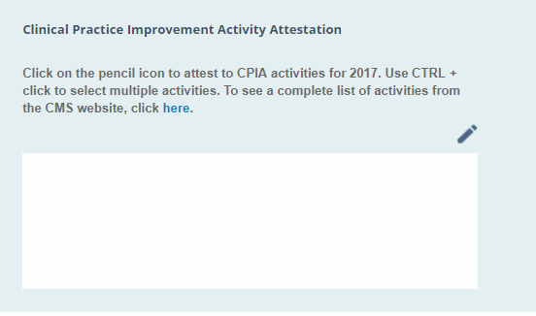
Improvement Activities (IA) – Individual Attestation
Edit Provider Page – scroll down to the bottom of the page
Click on the pencil

Slide 8
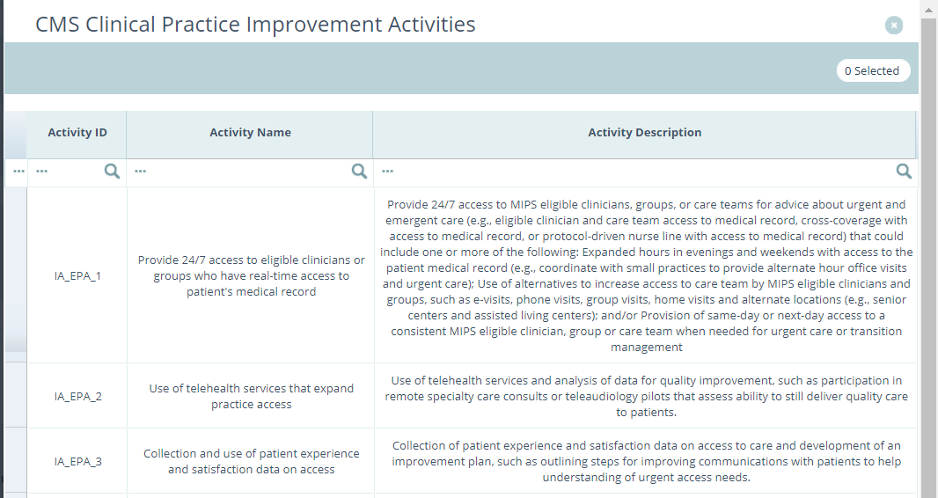
Improvement Activities (IA) – Individual Attestation
A list of the Improvement Activities will appear with their ID, name and description.

Slide 9
Improvement Activities (IA) – Individual Attestation
Select the activity for which you want to attest
Click on Apply

Slide 10
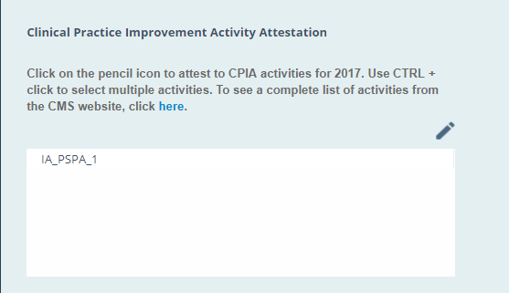
Improvement Activities (IA) – Individual Attestation
Activity will show as complete
Click “Save” before exiting the provider

Slide 11
Improvement Activities (IA) Date Selection
Go to the Practice List, the icon within the navigation menu on the left side of the screen and select your practice to edit
Once in the “Edit Practice” window, scroll down to the Improvement Activities section
The Practice Champion must select the date ranges that match the dates in which the improvement activity was done within the practice.
Example: IA_PSPA_1 (participation in an AHRQ-listed PSO for 90 days

Slide 12
Improvement Activities (IA) – Individual Attestation
To double check the attestation was completed, return to the provider list. Activity will also show as complete in the CPIA Reported Column

Slide 13
Attesting to an Improvement Activity – Group Attestation

Slide 14
Improvement Activities (IA) – Group Attestation
Attest through the Provider List in the NACOR Dashboard
Select the Admin Dashboard Icon

Slide 15
Improvement Activities (IA) – Group Attestation
Click the arrow for the drop down list ( ) under Provider Management

Slide 16
Improvement Activities (IA) – Group Attestation
Click on “Add CPIA to Providers”

Slide 17
Improvement Activities (IA) – Group Attestation
Admin Dashboard/Provider List will appear

Slide 18
Improvement Activities (IA) – Group Attestation
Select the drop down menu for the list of Improvement Activities

Slide 19
Improvement Activities (IA) – Group Attestation
Select the Improvement Activity for which you want to attest

Slide 20
Improvement Activities (IA) – Group Attestation
Select the providers for whom you wish to attest, then click submit
# of Providers selected will appear here
Click on each provider that you would like to attest

Slide 21
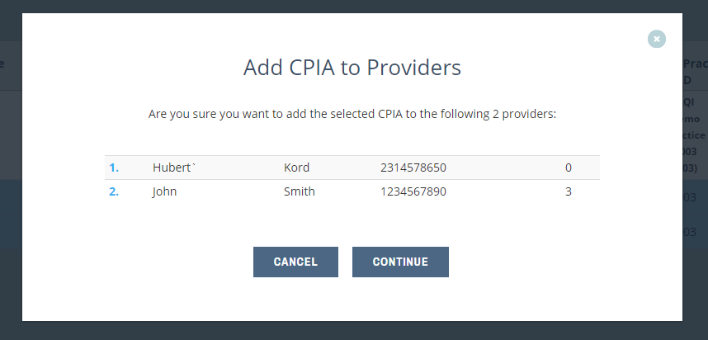
Improvement Activities (IA) – Group Attestation
The following screen will appear:
If the information is correct select “Continue”if not select “Cancel”

Slide 22
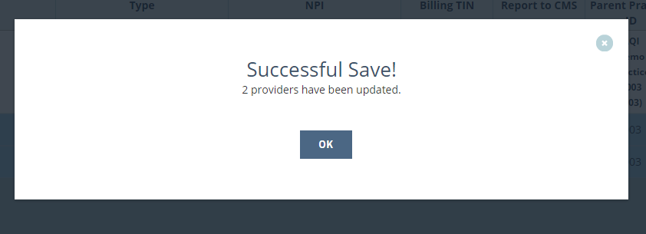
Improvement Activities (IA) – Group Attestation
If you selected “Continue” on the previous screen this message will appear.

Slide 23
Improvement Activities (IA) – Individual Attestation
Activity will also show as complete in the CPIA Reported Column

Slide 24
Improvement Activities (IA) Date Selection
Go to the Practice List, the icon within the navigation menu on the left side of the screen and select your practice to edit
Once in the “Edit Practice” window, scroll down to the Improvement Activities section
The Practice Champion must select the date ranges that match the dates in which the improvement activity was done within the practice.
Example: IA_PSPA_1 (participation in an AHRQ-listed PSO for 90 days

