Slide 1
Quality Reporting Office Hours
Annette Antos, AQI Registry Manager
Leslie Kociemba, ASA Quality Associate
July 11, 2017

Slide 2
Agenda
QRA Update
Updated Measure IDs
Measure Specification Clarifications
‘E’ Designation
Inverse measures
Reminders
Measure Resources

Slide 3
Agenda
AQI Update
MACRA Reporting Workshop
New Data Submission Process
Roles of ePreop and ArborMetrix
Merging/Formatting Data Files
2017 Quality Reporting Renewals
2017 Quality Reporting Deadlines

Slide 4
Updated Measure IDs
Measure Title | Initial Measure ID Given | CORRECT Measure ID
Postanesthesia Care Unit (PACU) Reintubation Rate | AQI49 | AQI31
Adherence to Blood Conservation Guidelines for Cardiac Operations using Cardiopulmonary Bypass (CPB) – Composite | AQI50 | AQI49
Application of Lung-Protective Ventilation during General Anesthesia | AQI51 | AQI50
Assessment of Patients for Obstructive Sleep Apnea | AQI52 | AQI51
Treatment of Hyperglycemia with Insulin | AQI53 | AQI52

Slide 5
Measure Specification Clarifications
Elimination of ‘E designation’ exclusion
Adherence to Blood Conservation Guidelines for CPB = only measure with denominator exclusion for emergent cases
Inverse Measures
AQI18: Coronary Artery Bypass Graft (CABG): Prolonged Intubation
AQI31: Postanesthesia Care Unit (PACU) Re-intubation Rate
AQI34: Perioperative Cardiac Arrest
AQI35: Perioperative Mortality Rate
AQI41: Coronary Artery Bypass Graft (CABG): Stroke
AQI42: Coronary Artery Bypass Graft (CABG): Post-Operative Renal Failure

Slide 6
REMINDERS
Use the 2017 measure specifications
2016 specifications will NOT be accepted
Update coding and measure numbers to reflect new formats
When in doubt, refer to the specification
If electing the 90-day Pick-Your-Pace option, you MUST begin collecting data no later than October 2, 2017

Slide 7
Measure Resources
Go to www.aqihq.org for measure specifications, guides and technical resources.
2017 QCDR Measure Booklet
2017 QCDR Measure Specifications Table
2016/2017 QCDR Measure ID Crosswalk
2016/2017 QCDR Measure Codes Crosswalk
2017 MIPS at a Glance (31 MIPS measures)

Slide 8
Quality and Regulatory Affairs (QRA) Update (June 2017)
Questions and comments on quality measures and regulatory information (e.g. reporting requirements, CMS regulation) should be sent to Quality and Regulatory Affairs staff.
*****
Quality and Regulatory Affairs (qra@asahq.org)
http://www.asahq.org/quality-and-practice-management/quality-improvement
*****
ASA MACRA Webpage:
http://www.asahq.org/quality-and-practice-management/macra
*****
CMS Quality Payment Program Website:
http://www.qpp.cms.gov

Slide 9
2017 AQI MACRA Reporting Workshop
September 8, 2017 ASA Headquarters - Schaumburg, IL
Agenda
2017 MACRA reporting requirements
How to select quality measures and improvement activities for your practice
Practice Roles and Responsibilities
Tools and strategies for your successful participation in the AQI National Anesthesia Clinical Outcomes Registry this year.
$400 - ASA Member (M.D. or administrator)/$500 - Non-ASA Member

Slide 10
AQI – New Data Submission Process
New Submission Portal began July 10, 2017
Emails with the new User Account information were sent to the practice and/or vendor on July 7th.
After file upload, 1 business day to receive feedback email.
If you did not receive the login information or need assistance with the new ftp email nacorsupport@arbormetrix.com.

Slide 11
AQI – ePreop and ArborMetrix Roles
ePreop
Data Intake
Data Validation
Data File Feedback Reports
ArborMetrix
Data Processing
Data Analysis and Reporting
Data Submission to CMS

Slide 12
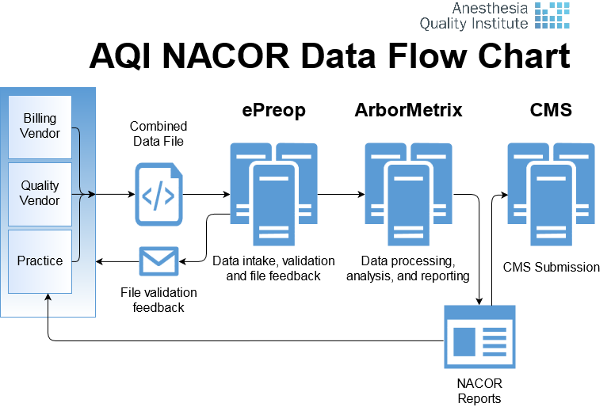
AQI – ePreop and ArborMetrix roles

Slide 13
AQI – ePreop/ArborMetrix Questions
All questions regarding the following should be sent to nacorsupport@arbormetrix.com
File Upload
FTP access
Data Validation feedback reports
Deleting/Reloading Files
CMS Quality Reports

Slide 14
AQI – Merging/Formatting Files
Effective July 1, 2017 AQI will no longer merge and format data files.
If you need assistance with either of these services email askaqi@asahq.org to schedule a 30 minute call with ePreop to discuss service options.

Slide 15
2017 Quality Reporting Renewals
All Practice Champions received a letter and email the 1st week of June outlining the new process
Order Form
Indicate provider quantities for both ASA Current Members and ASA Non-Members participating in reporting in MIPS Quality Reporting
Reporting Option
GPRO vs Individual
QR vs QCDR
If you have not received the order form link email askaqi@asahq.org.

Slide 16
AQI – 2017 Quality Reporting Deadlines
 | Deadline
Registration/Renewal Deadline | October 31, 2017
January-November 2017 Data | January 31, 2018
December 2017 Data | February 15, 2018
Eligible Clinician (EC) Opt-Out of 2017 Quality Reporting | February 15, 2018

Slide 17
Next Quality Reporting Office Hours
Tuesday, August 8, 2017
11am CST or 5pm CST
11am: Registration URL: https://register.gotowebinar.com/register/5935894222816698626
5pm: Registration URL: https://register.gotowebinar.com/register/3300471505522886403

